Slide 1
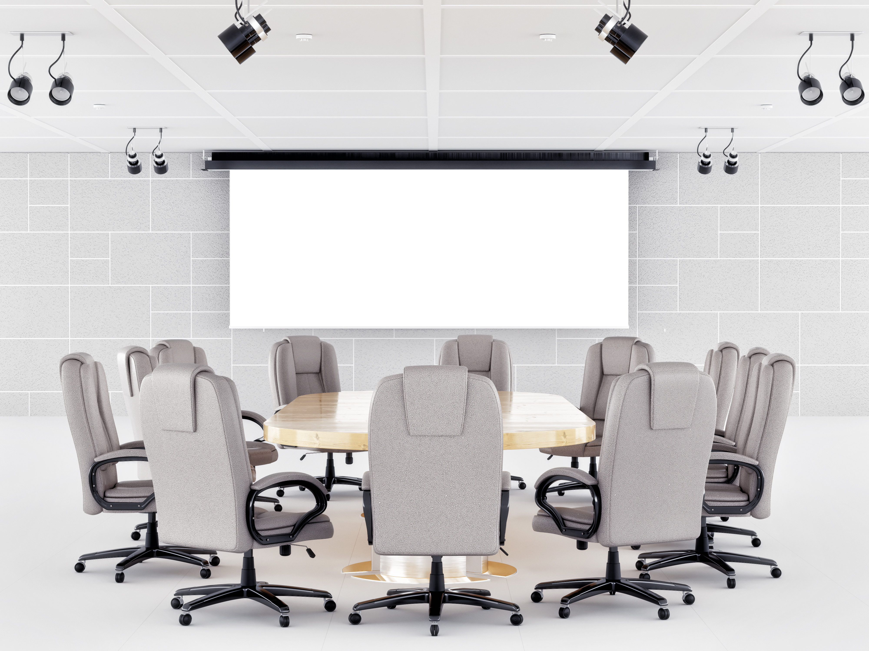




Steve Jones CEO and EVP
Phil Ryder
VP of Sales
Sarah Brown VP of Marketing
Notes:
Magic move (or morph in PPT) is a great way to build continuity throughout your deck. As you see in this example, one element always exists and moves to the next slide, building a nice little flow.

Slide 2


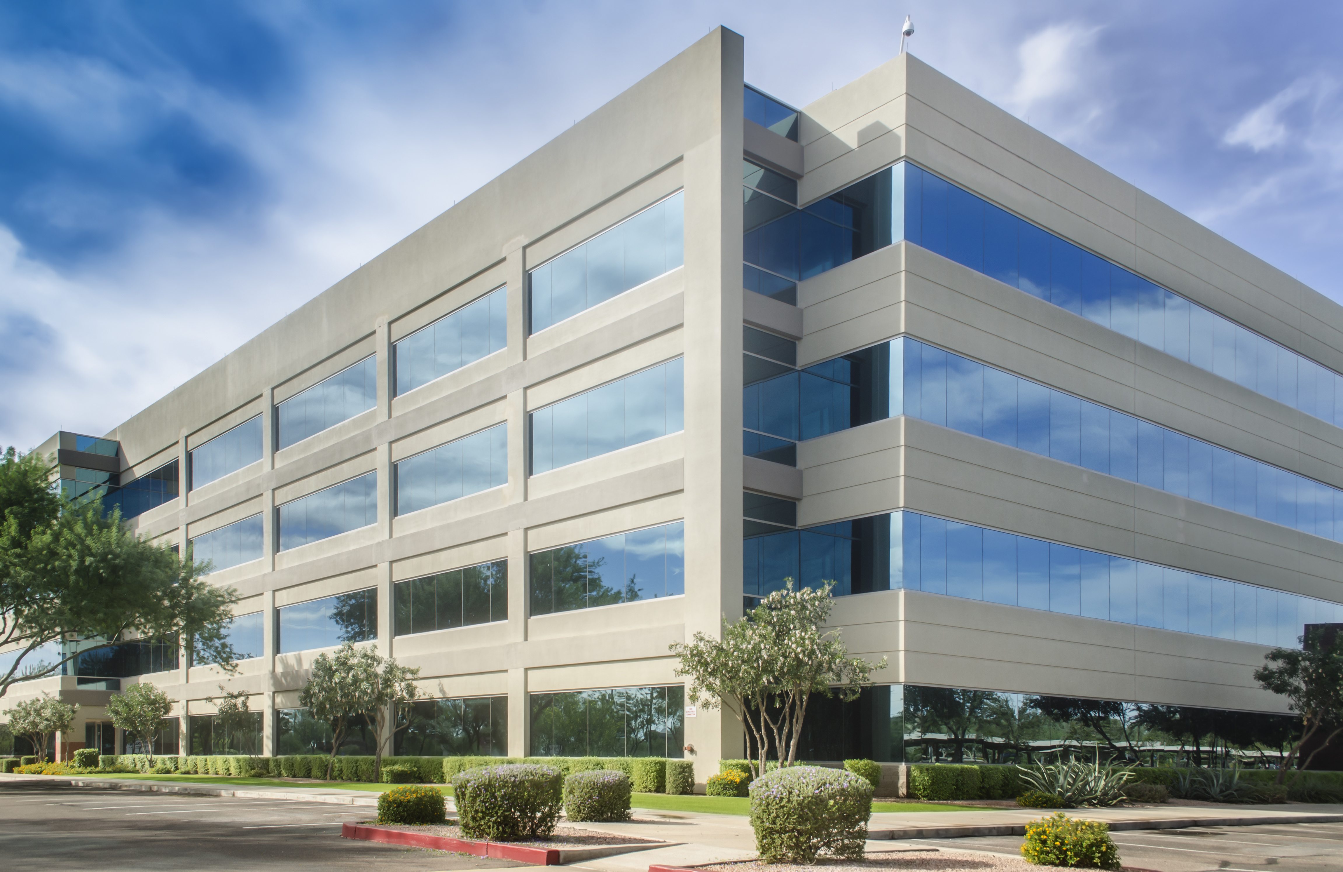

Steve Jones CEO and EVP
Sarah Brown VP of Marketing
Phil Ryder
VP of Sales

Slide 3
UK
China
Bay Area
Notes:
We are Elemental LED, an engineering and technology company, and America’s leading provider of linear LED lighting. We are based in the San Francisco Bay Area, the technology hub of the world. As of today, we boast over 40,000 square feet of multi-campus facilities as well as personnel in the United Kingdom and China. Our campus consists of:
• Corporate offices
• Training facilities
• One of the largest call centers in the industry
• And an Operations Center which encompasses our state of the art manufacturing division, testing labs and engineering facilities.

Slide 4
SERVICE
ENGINEERING
QUALITY
Notes:
We know you have choices – Google the term LED and you won’t be able to read all the pages of results – but we believe in focusing on:
Service – from design through implementation
Engineering – recognizing the latest trends and creating new solutions that lead the market in solving industry challenges
Quality – consistently improving our products’ light output, color rendering (CRI) and efficacy

